Slide 1
Bùi Xuân Hải
HE200952
Project 2 :
8-bit RISC Processor Core with a 5-Stage Pipeline

Slide 2
Processor Specifications & Key Features
Architecture: Harvard (Separate Instruction & Data memory)
Data Width: 8-bit Datapath & PC | 16-bit Instructions
Storage: 8 General-Purpose Registers (R0-R7) | 2 Flags (Z, C)
Pipeline: 5-Stage (IF - ID - EX - MEM - WB)
Implementation: Hardware hazard resolution | Synthesized on Xilinx Vivado (Artix-7)

Slide 3
Instruction Set Architecture (ISA)
Fixed 16-bit Instruction Format:
[15:12]: Opcode (4 bits) -> Supports exactly 16 instructions.
[11:9]: Destination Register rd (3 bits).
[8:0]: Source Registers (rs1, rs2), Immediate values, or Addresses.
Instruction Categories (16 Instructions):
ALU & Shift: ADD, SUB, AND, OR, XOR, SHL, SHR
Immediate: LDI, ADDI
Memory Access: LD, ST
Control Flow (Branching): JMP, BZ, BNZ, HLT

Slide 4
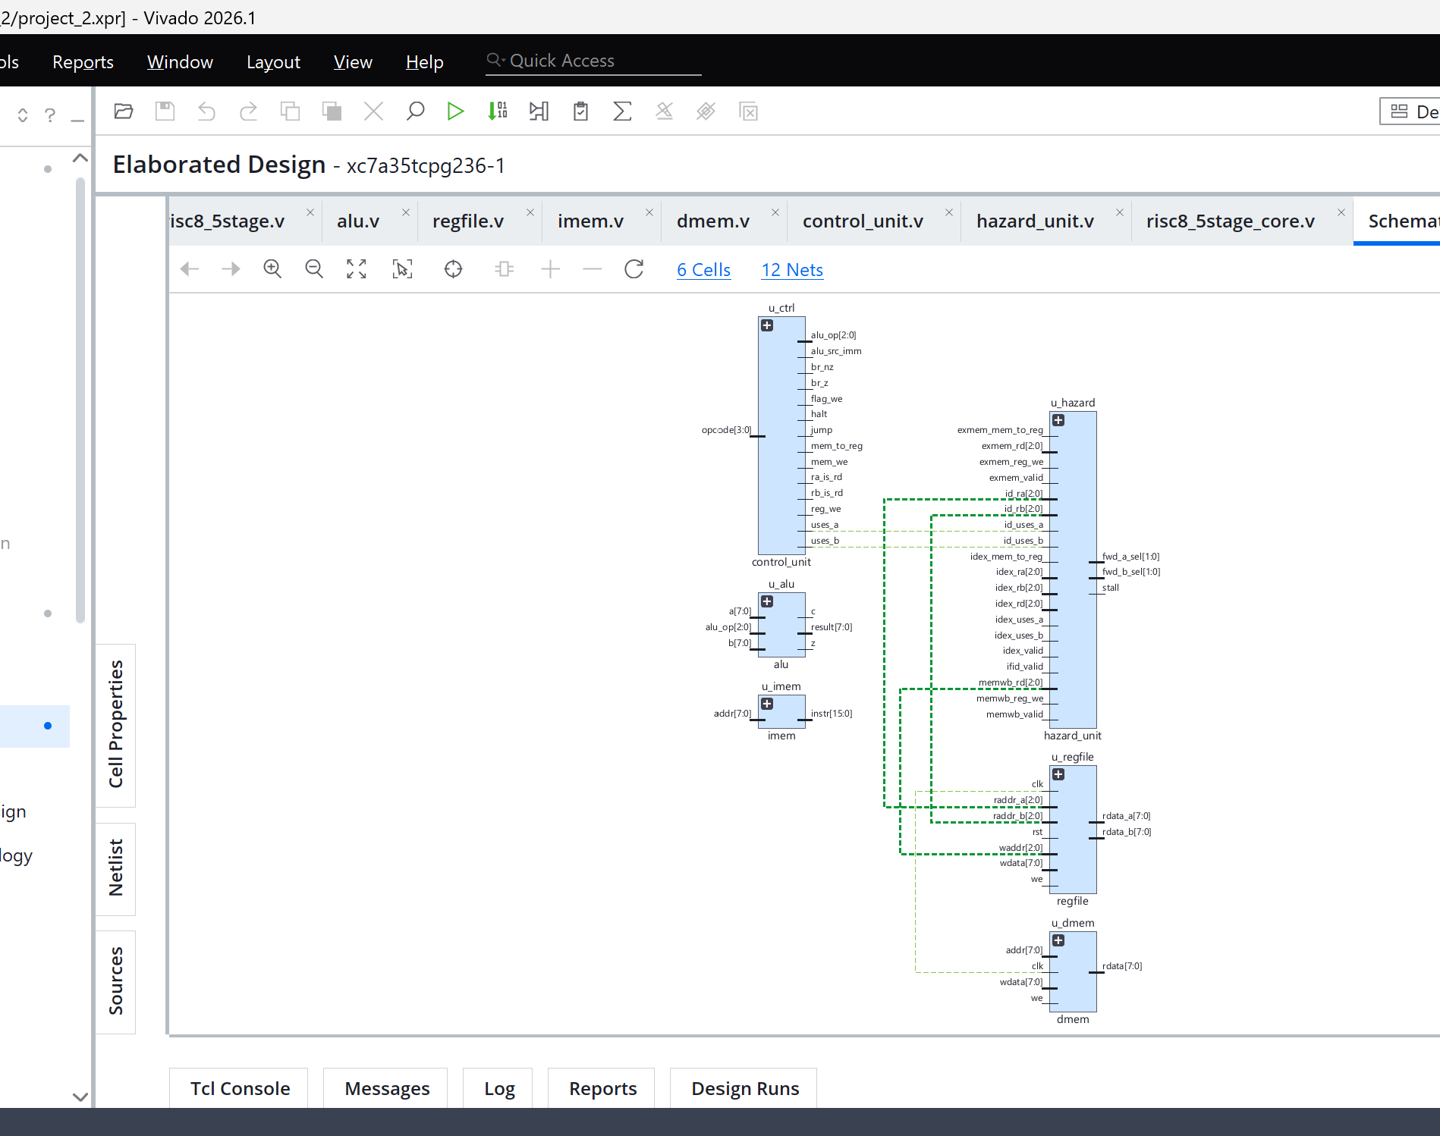
Top-Level Architecture (RTL Modules)
imem & dmem: Instruction ROM (256x16) and Distributed LUT-RAM (256x8).
control_unit: Combinational decoder generating 14 control signals.
regfile: 8x8-bit register file featuring Write-through bypass.
alu: Performs arithmetic/logic and updates Z, C flags.
hazard_unit: Detects data/control hazards and outputs Stall/Forwarding signals.

Slide 5
The 5-Stage Datapath & Pipeline Control
5. Datapath & Pipeline Control
5 Processing Stages:
IF (Instruction Fetch): Fetch instruction from imem, update PC.
ID (Instruction Decode): Decode opcode, read regfile, check hazards.
EX (Execute): ALU operations, calculate branch targets.
MEM (Memory Access): Read/Write to dmem.
WB (Write-Back): Write final results back to regfile.
Pipeline Registers & Principle:
4 Barrier Registers: IF/ID, ID/EX, EX/MEM, MEM/WB.
"Control travels with data": Signals are decoded in ID, but propagate through registers to trigger EX, MEM, and WB at the correct clock cycles.

Slide 6
Pipeline Hazard Resolution
Data Hazards (RAW): Resolved via Data Forwarding & Bypass (0-cycle penalty). Results from EX/MEM or MEM/WB are routed directly to ALU inputs.
Load-Use Hazards: Resolved via 1-Cycle Stall. Hardware freezes PC and IF/ID, inserting a "bubble" if an instruction immediately depends on a LD.
Control Hazards: Resolved via 2-Cycle Flush. Branch decisions happen at EX stage. If a branch is TAKEN, the 2 wrong-path instructions in IF and ID are flushed.

Slide 7
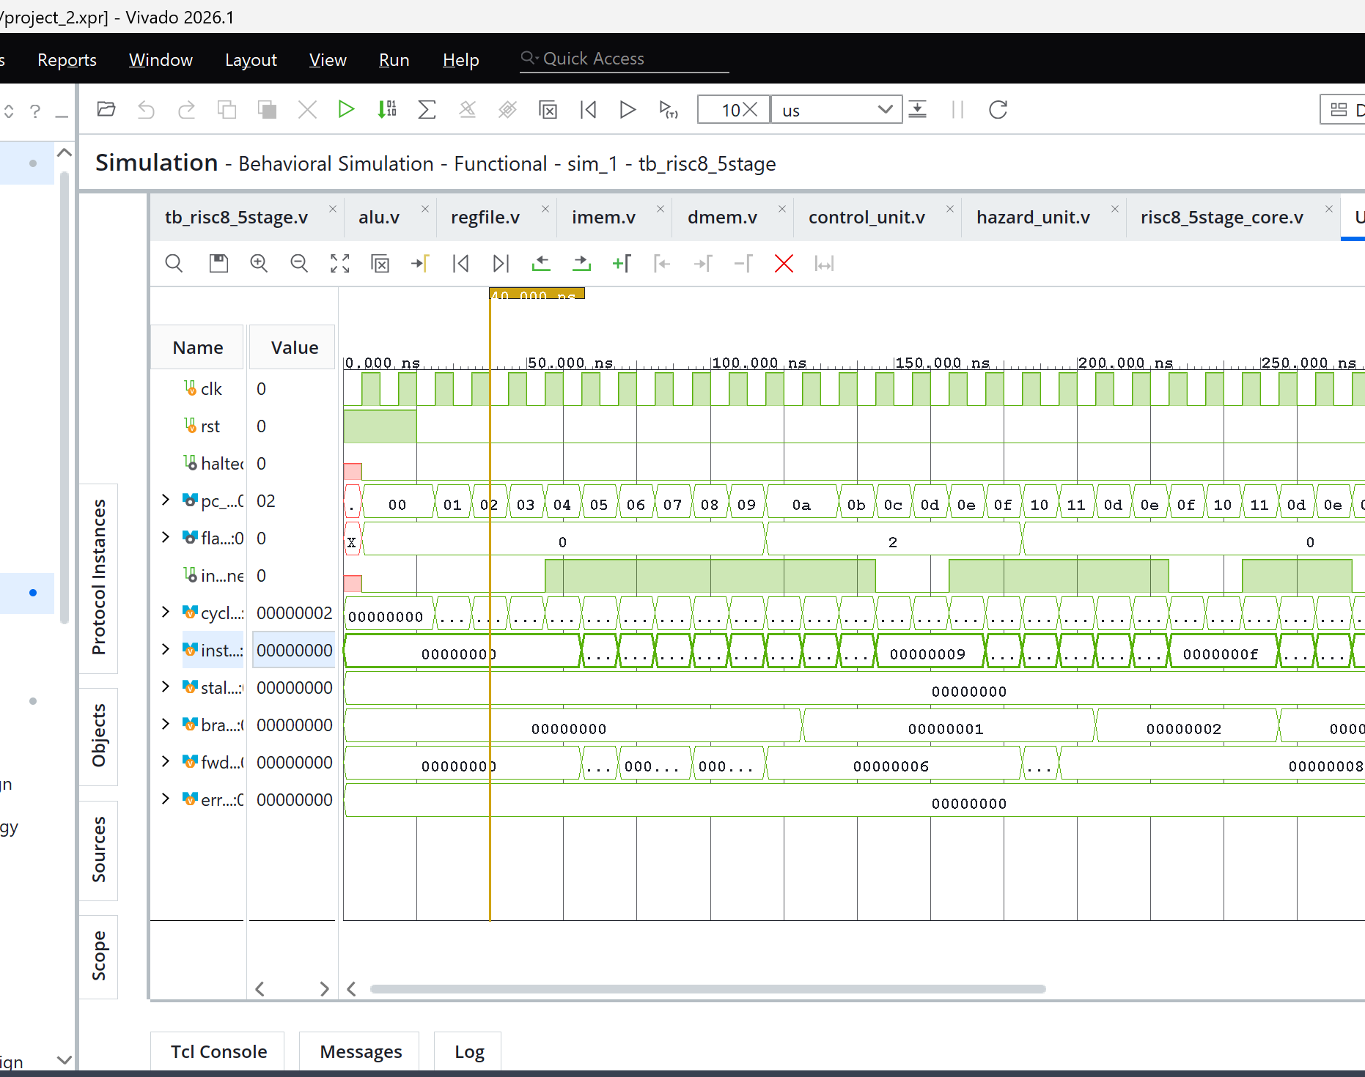
Detailed Waveform Analysis
Pipeline Fill: Initial 4-cycle delay before the first instr_done (Pipeline depth = 5).
Data Forwarding (0-Cycle Penalty): fwd_count increases actively, but stall_count remains strictly 0.
Control Hazard (2-Cycle Penalty): When branch_count increments, instr_done drops to 0 for exactly 2 cycles (Wrong-path instructions flushed).

Slide 8
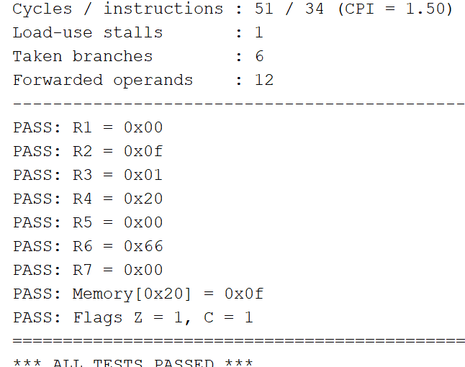
Summary log

